Slide 1
ASSIGNMENT- 3
Data Analytics with Tableau
PATHA LAKSHMI SAI PRIYA
20NN1A05G3
IV B.TECH (CSE)
VIGNAN’S NIRULA INSTITUTE OF TECHNOLOGY AND SCIENCE FOR WOMEN (VNITSW)

Slide 2
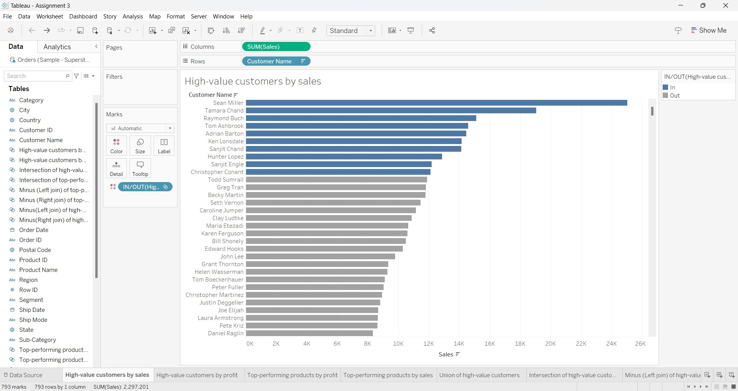
HIGH-VALUE CUSTOMERS BY SALES

Slide 3
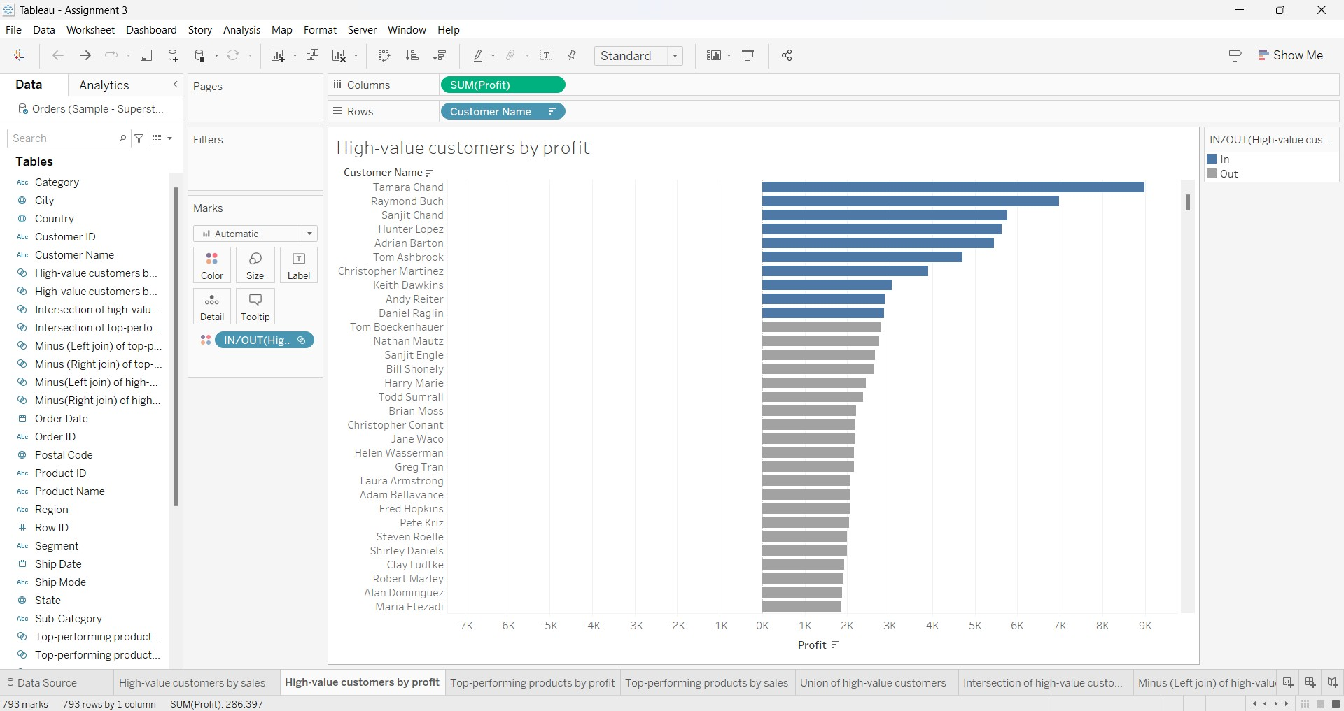
HIGH VALUE CUSTOMERS BY PROFIT

Slide 4
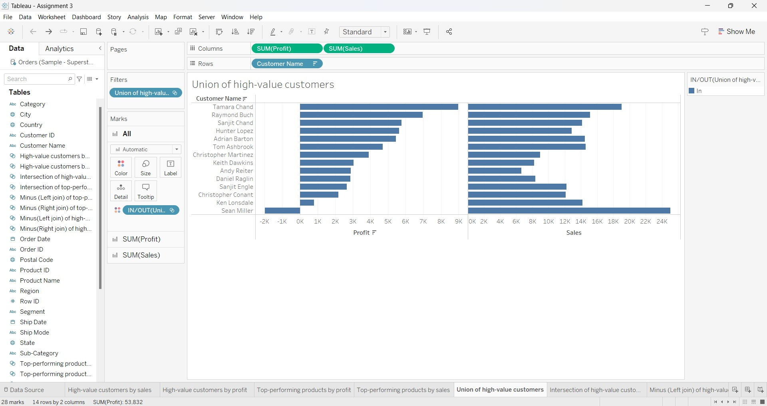
UNION OF HIGH-VALUE CUSTOMERS

Slide 5
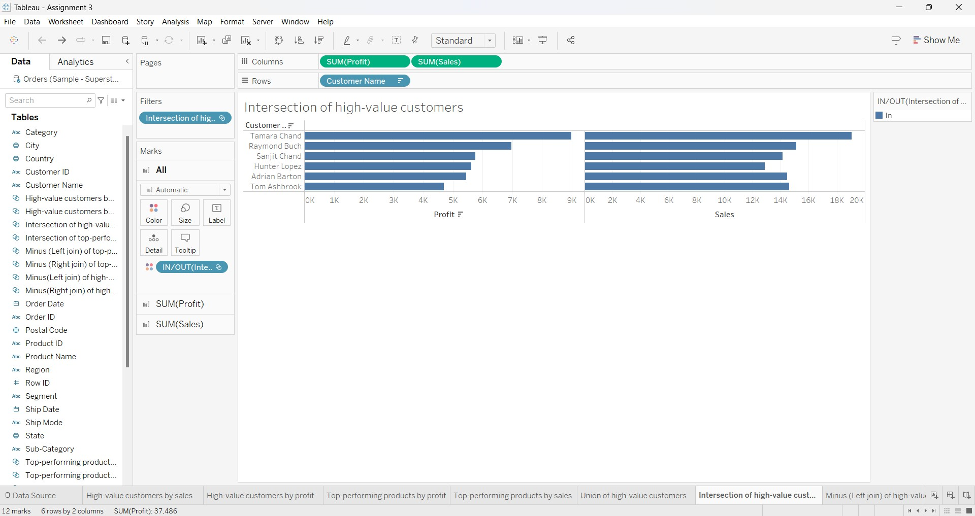
INTERSECTION OF VALUE CUSTOMERS

Slide 6
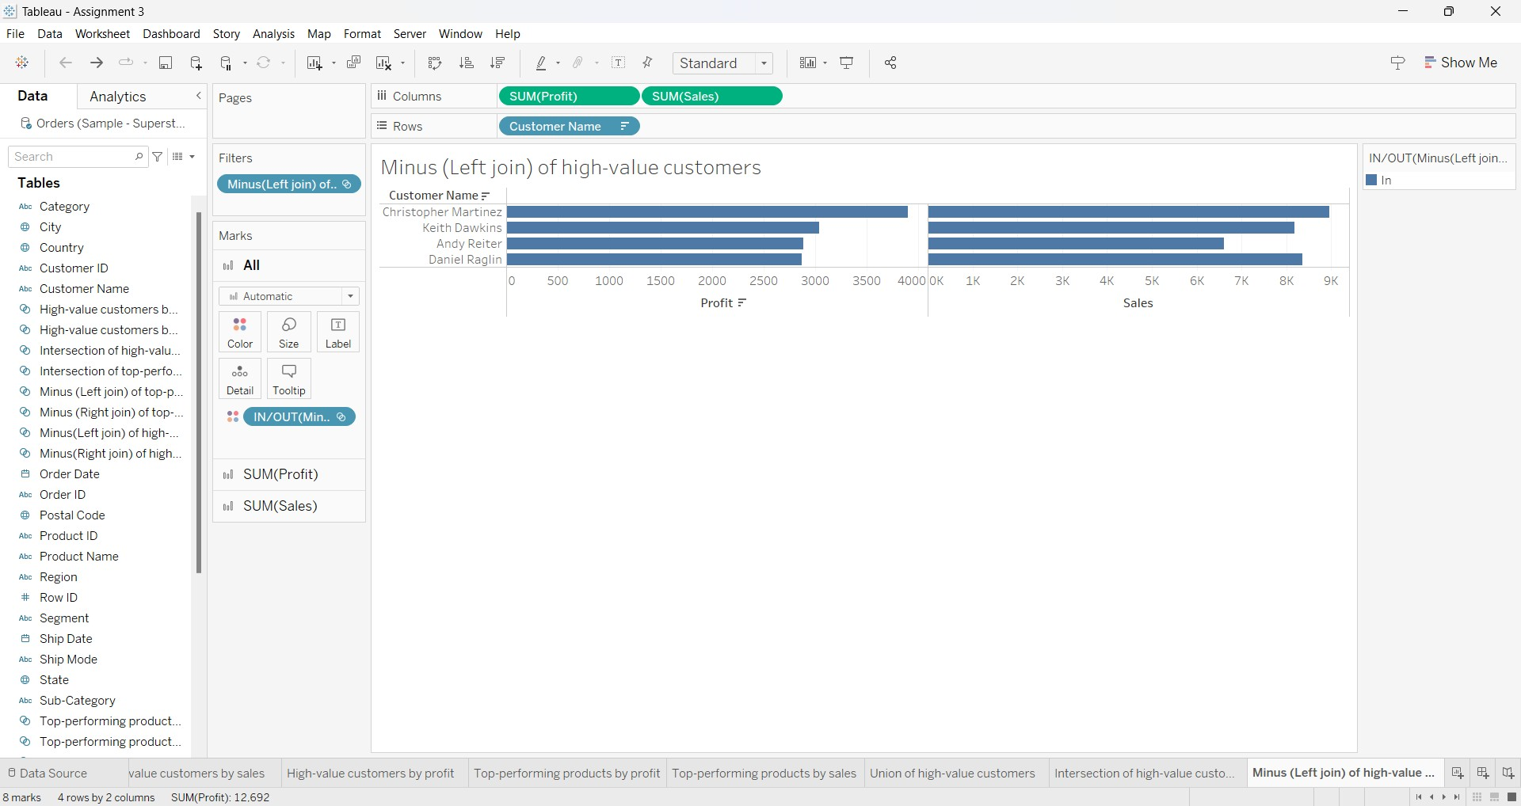
MINUS(LEFT JOIN) OF HIGH-VALUE CUSTOMERS

Slide 7
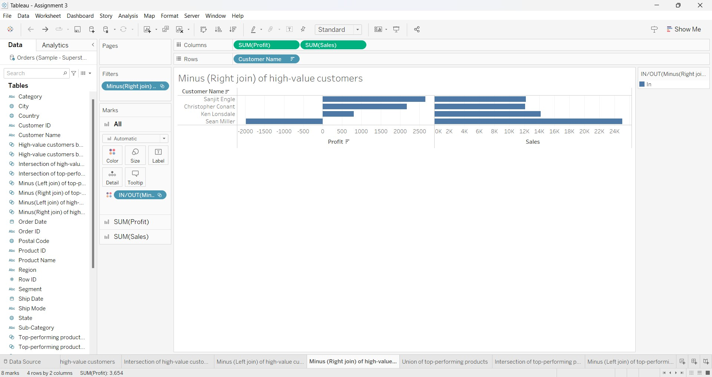
MINUS(RIGHT JOIN) OF HIGH-VALUE CUSTOMERS

Slide 8
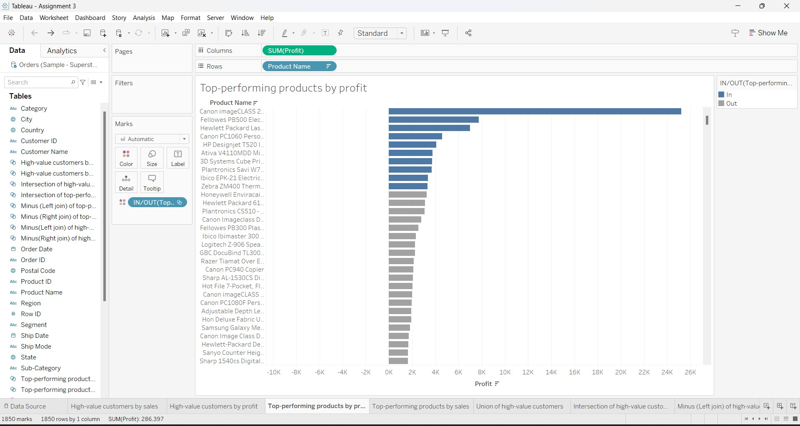
TOP-PERFORMING PRODUCTS BY PROFIT

Slide 9
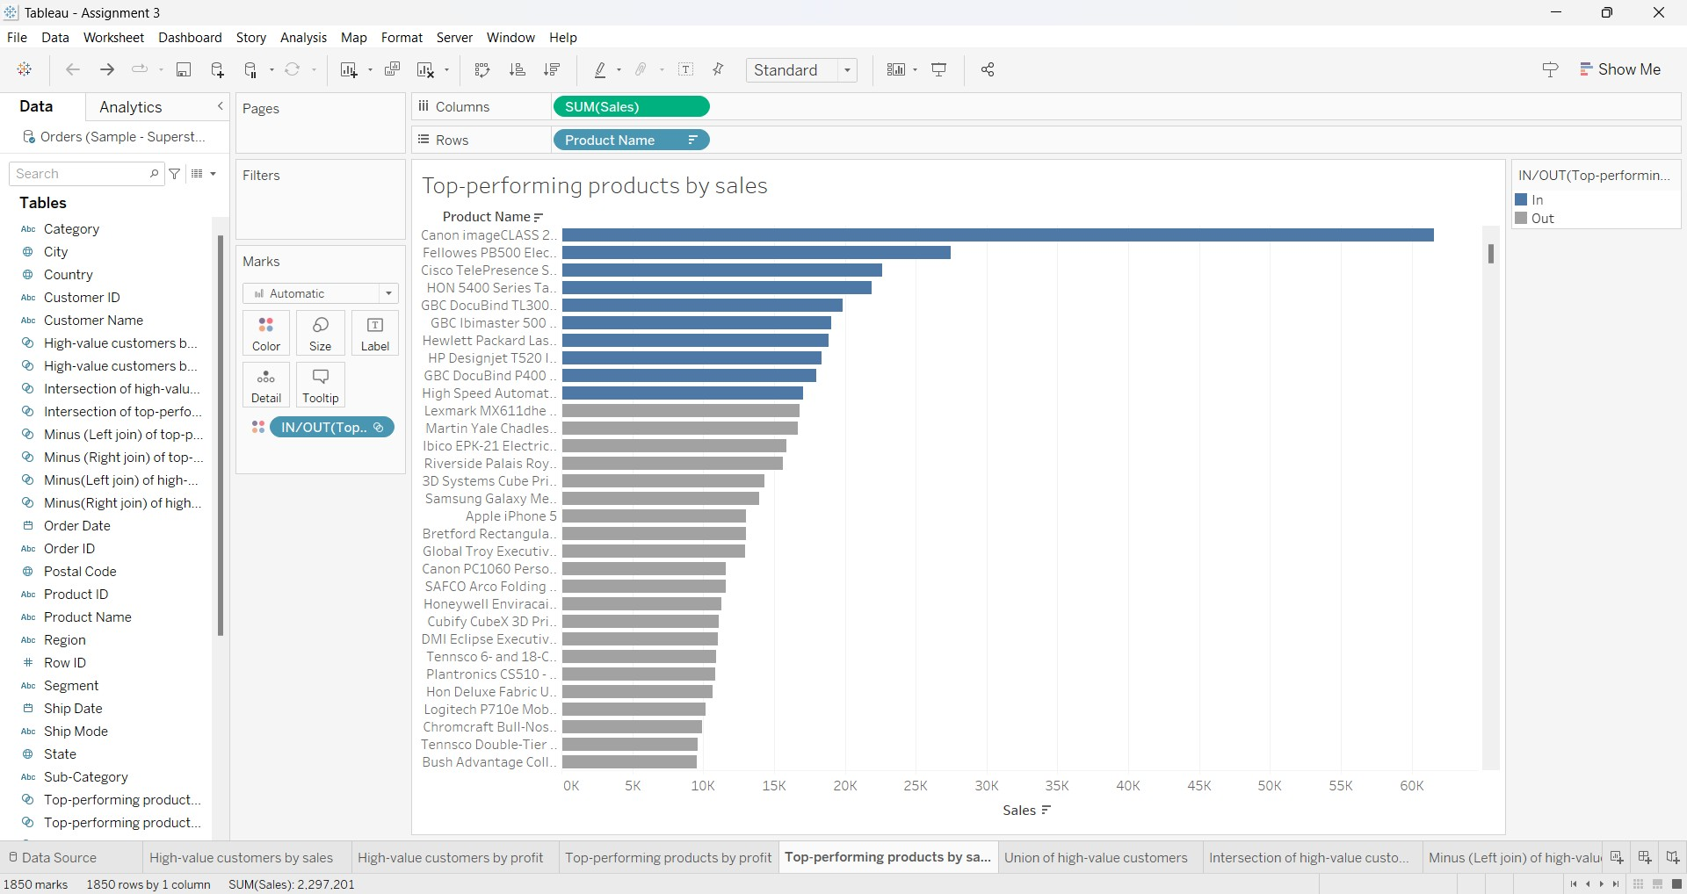
TOP PERFORMING PRODUCTS BY SALES

Slide 10
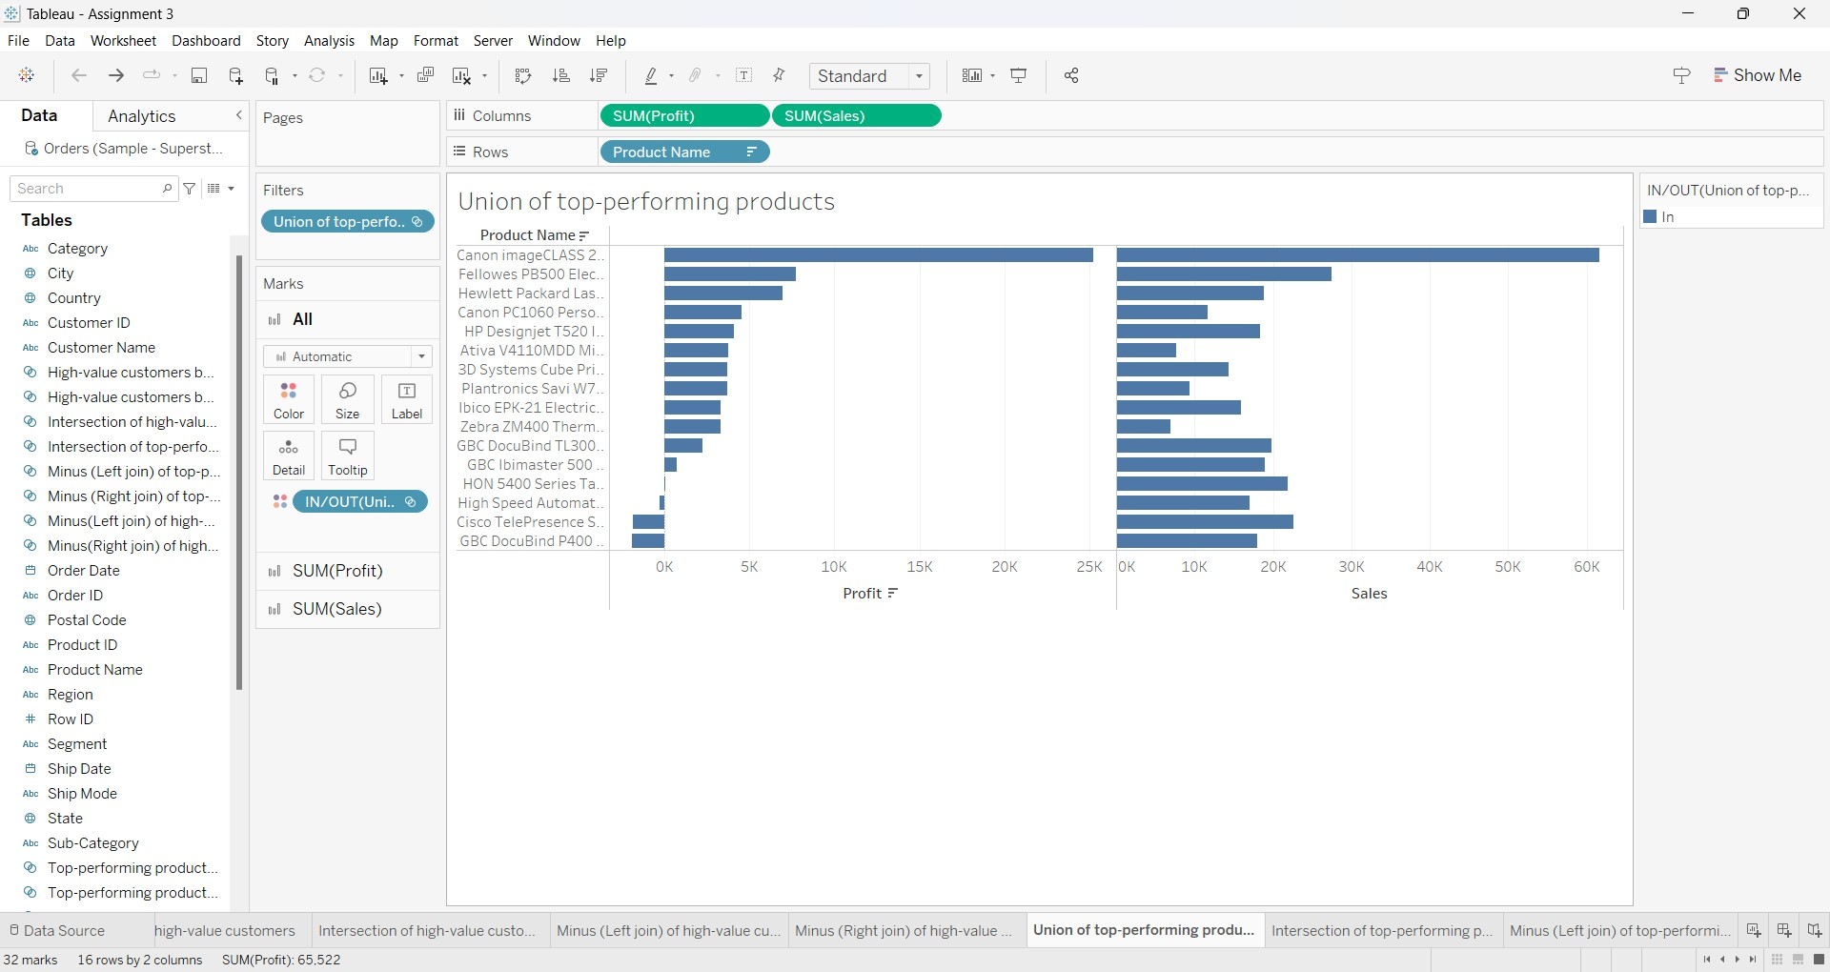
UNION OF TOP-PERFORMING PRODUCTS

Slide 11
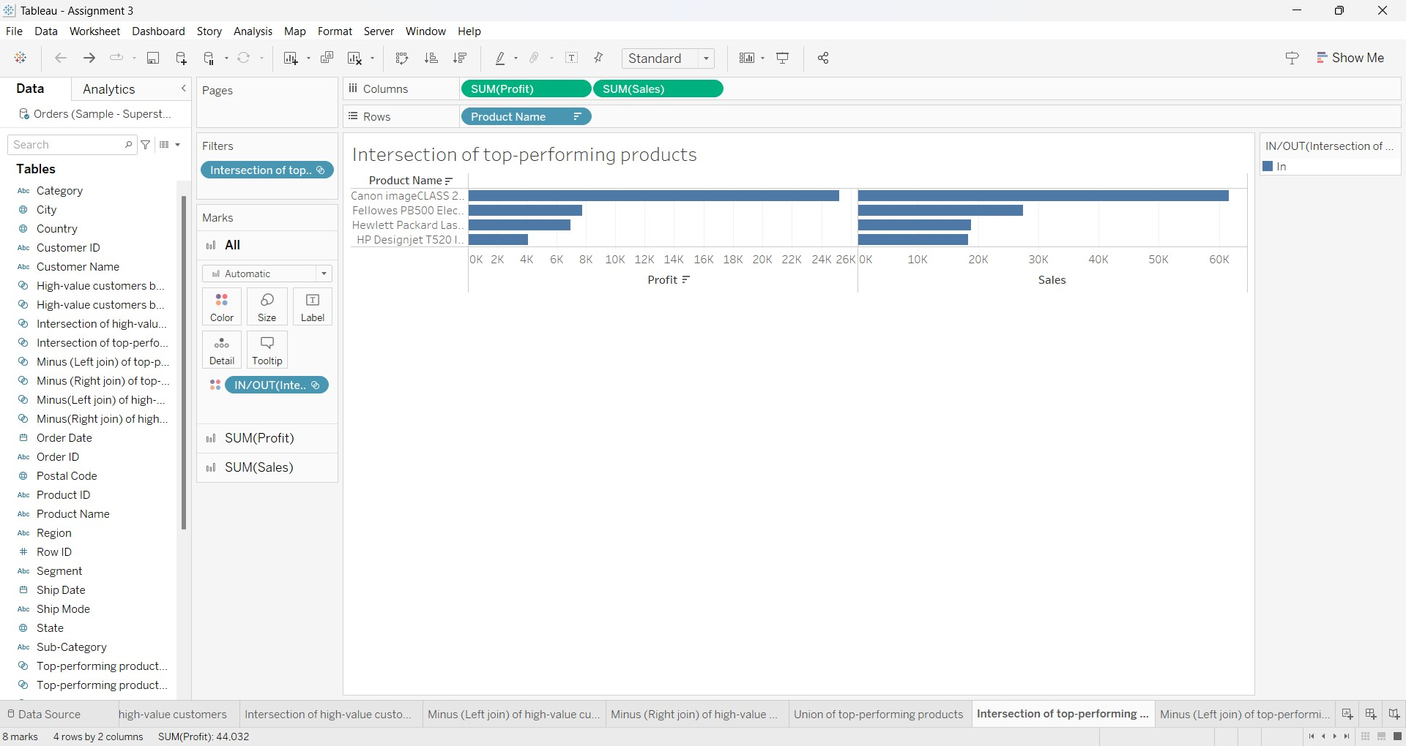
INTERSECTION OF TOP-PERFORMING PRODUCTS

Slide 12
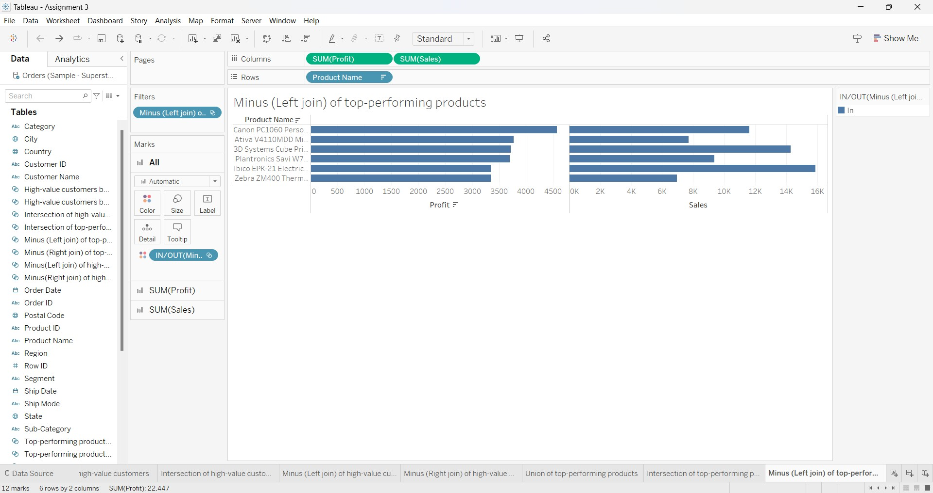
MINUS(LEFT JOIN) OF TOP PERFORMING PRODUCTS

Slide 13
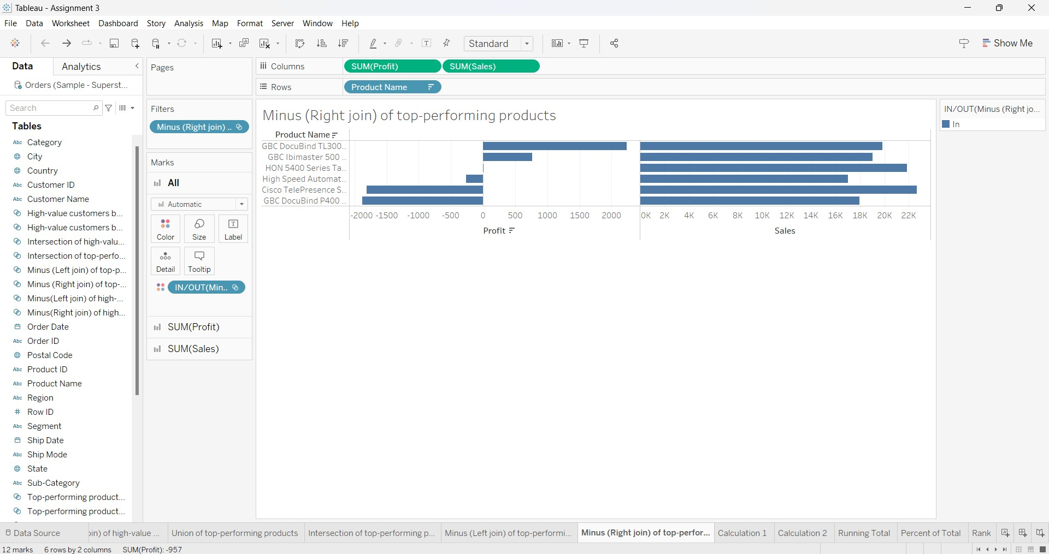
MINUS(RIGHT JOIN)OF TOP-PERFORMING PRODUCTS

Slide 14
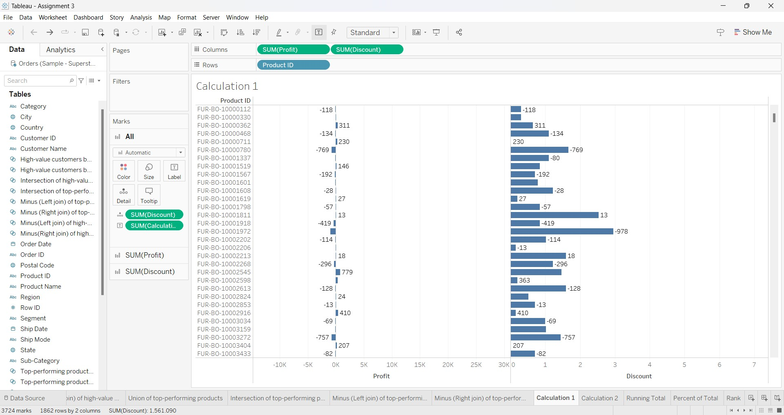
CALUCLATIONS:-

Slide 15
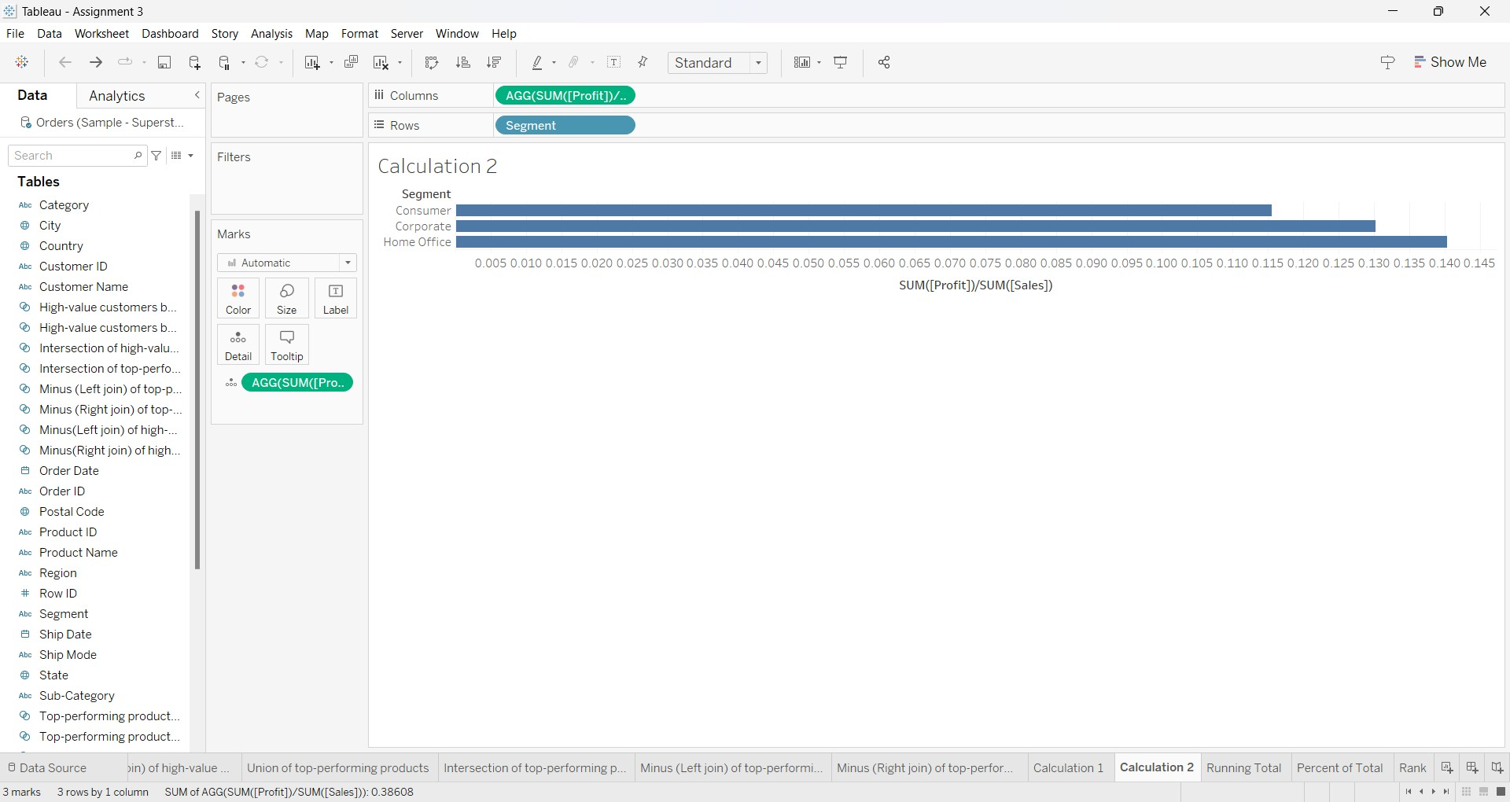

Slide 16
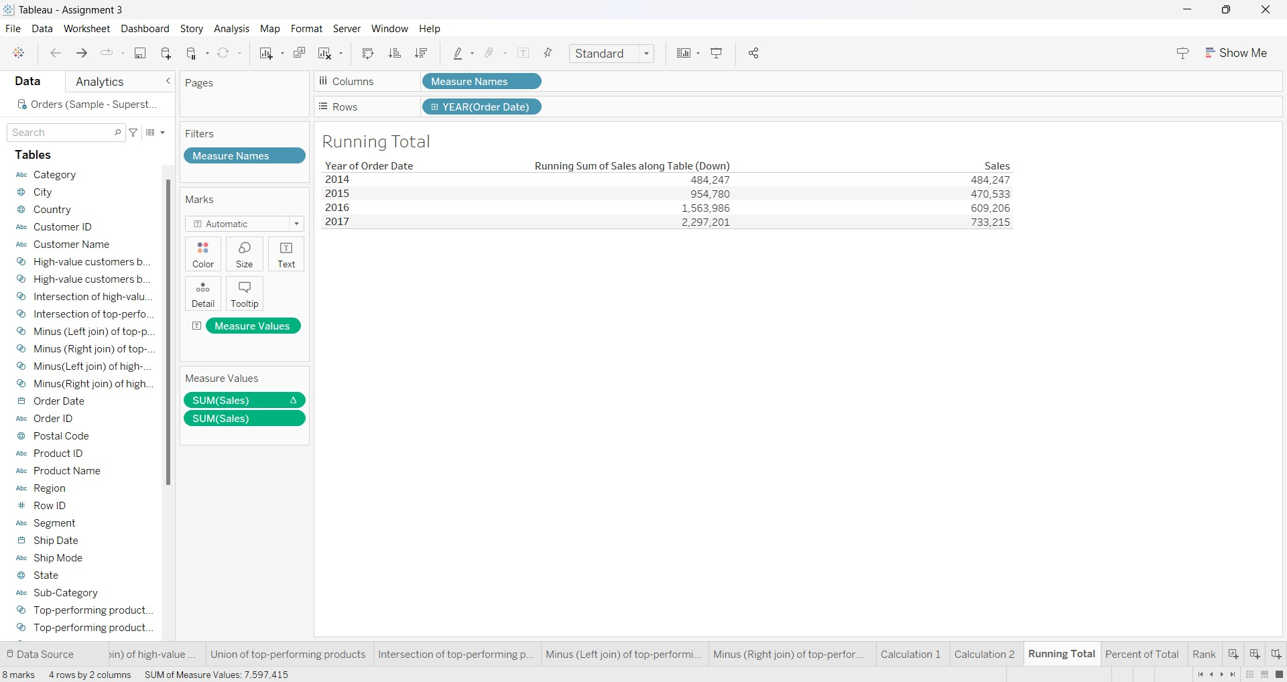
RUNNING TOTAL

Slide 17

TOTAL PERCENT:-

Slide 18
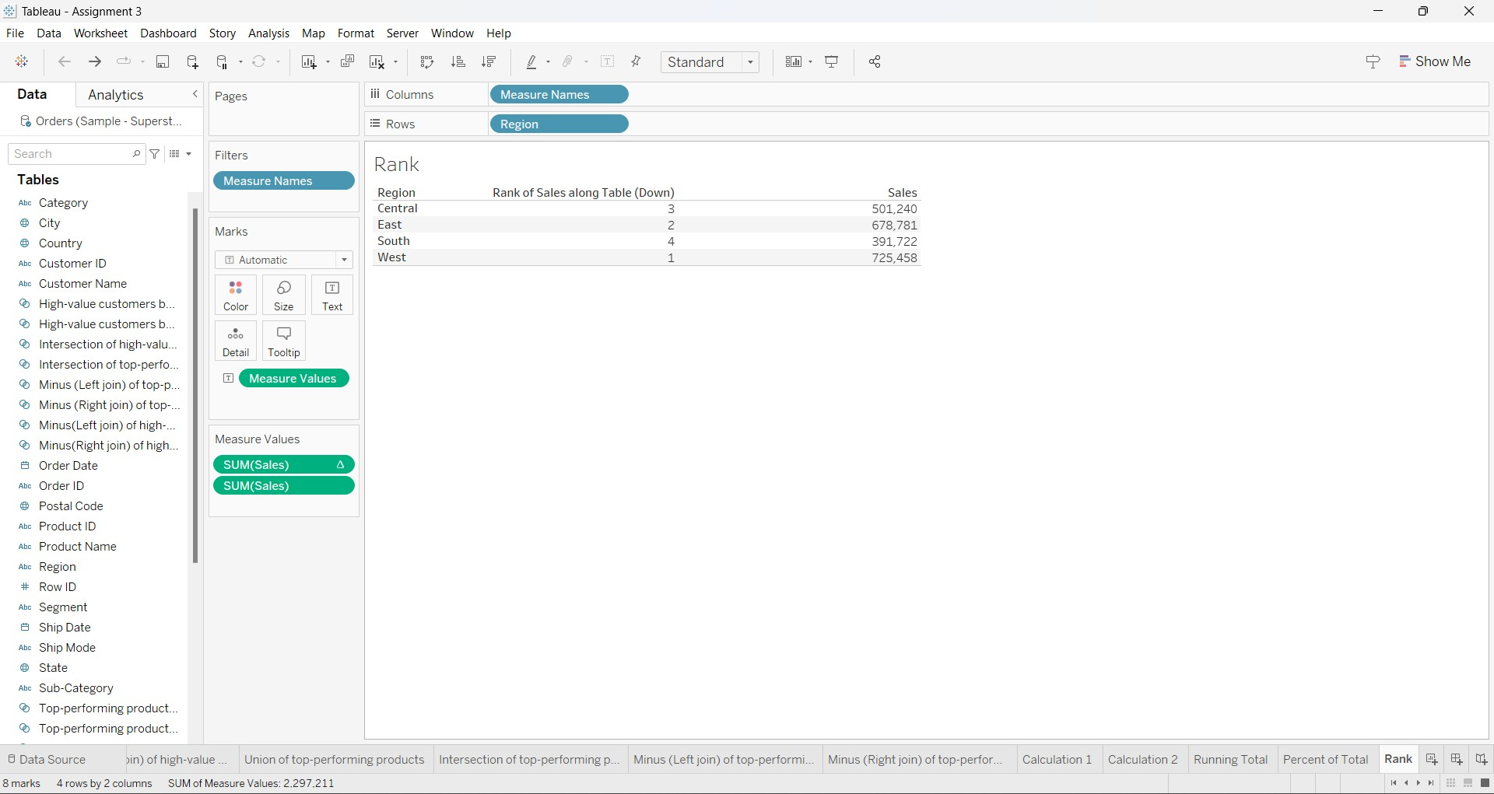
RANK:-

